Slide 1


Burn Surge Annex
Tabletop Exercise
Coalition Name
Date
Template provided by:

Slide 2
Instructions for Use of this PPT Template – Delete this slide prior to presentation
Edit these slides based on changes made by the
Exercise Planning Team to the Situation Manual
Template.
Language and information included here is
based on the template design and template
sample language.
Instructions for Use:
Helpful hints are included in these call-out boxes. Delete these prior to your presentation.
[delete prior to presentation]

Slide 3
Welcome and Introductions
Instructions for Use:
Add coalition or jurisdiction logo or seal to customize
[delete prior to presentation]
Name
Agency / Facility
Position / Role

Slide 4
Agenda
Time | Topic
8:00 AM – 8:30 AM | Introductions and opening remarks
8:30 AM – 9:00 AM | Overview of the HCC Burn Surge Annex / process during a mass burn event
9:00 AM – 9:40 AM | Module 1 – Initial incident
9:40 AM – 10:00 AM | Module 2 – First two hours
10:00 AM – 10:10 AM | BREAK
10:10 AM – 10:30 AM | Module 2 continued
10:30 AM – 11:10 AM | Module 3 – 4 hours out
11:10 AM – 11:50 AM | Wrap up and hotwash
Notes:
Today’s event has two purposes. We will provide a brief overview of the HCC Burn Surge Annex Plan to ensure all players have a general understanding of its content. Then we will conduct a tabletop exercise (TTX). The TTX is composed of three modules consisting of an initial incident and then the subsequent aftermath. Players in this exercise will participate in the following exercise module elements:
Module 1 – Initial Incident Period and Facility Response
Module 2 – Community Coordination
Module 3 – Transfer/Transport Coordination
Each module begins with a scenario update that summarizes the key events occurring within that time period. A series of questions following the scenario summary will guide the facilitated discussion of critical issues in each of the modules. Based on exercise priorities, time dedicated to each module will be managed by the facilitator.
Planning Note: Planners may change the event or the scope as needed to fit local considerations. Scenarios should still follow the modular approach in this sample.

Slide 5
Administrative Details
Restrooms
Fire Exits
Cell Phone Use
Materials

Slide 6
Introduction to HCC Burn Surge Annex
Instructions for Use:
Slides 6-8 describe the HCC Burn Surge Annex and must be filled in by the exercise planning team based on the specific information in the HCC annex. Feel free to add additional slides to the briefing.
[delete prior to presentation]
Goal
Scope
Purpose

Slide 7
Planning Assumptions
Instructions for Use:
To be completed by the Exercise Planning Team.
The plans may be in evolution / draft at this point – the attendees should understand that this exercise is designed to help explore, validate, and deconflict the burn plans in place. We don’t expect to have all the answers at this point.
[delete prior to presentation]
Add Assumptions
Add Assumptions

Slide 8
Triggers or Coalition-Specific Response Steps
Instructions for Use:
To be completed by the Exercise Planning Team.
Describe the thresholds or potential triggers for annex use, as well as the specifics of the response by the coalition members / disciplines.
[delete prior to presentation]
Insert Triggers
Specific Response Steps

Slide 9
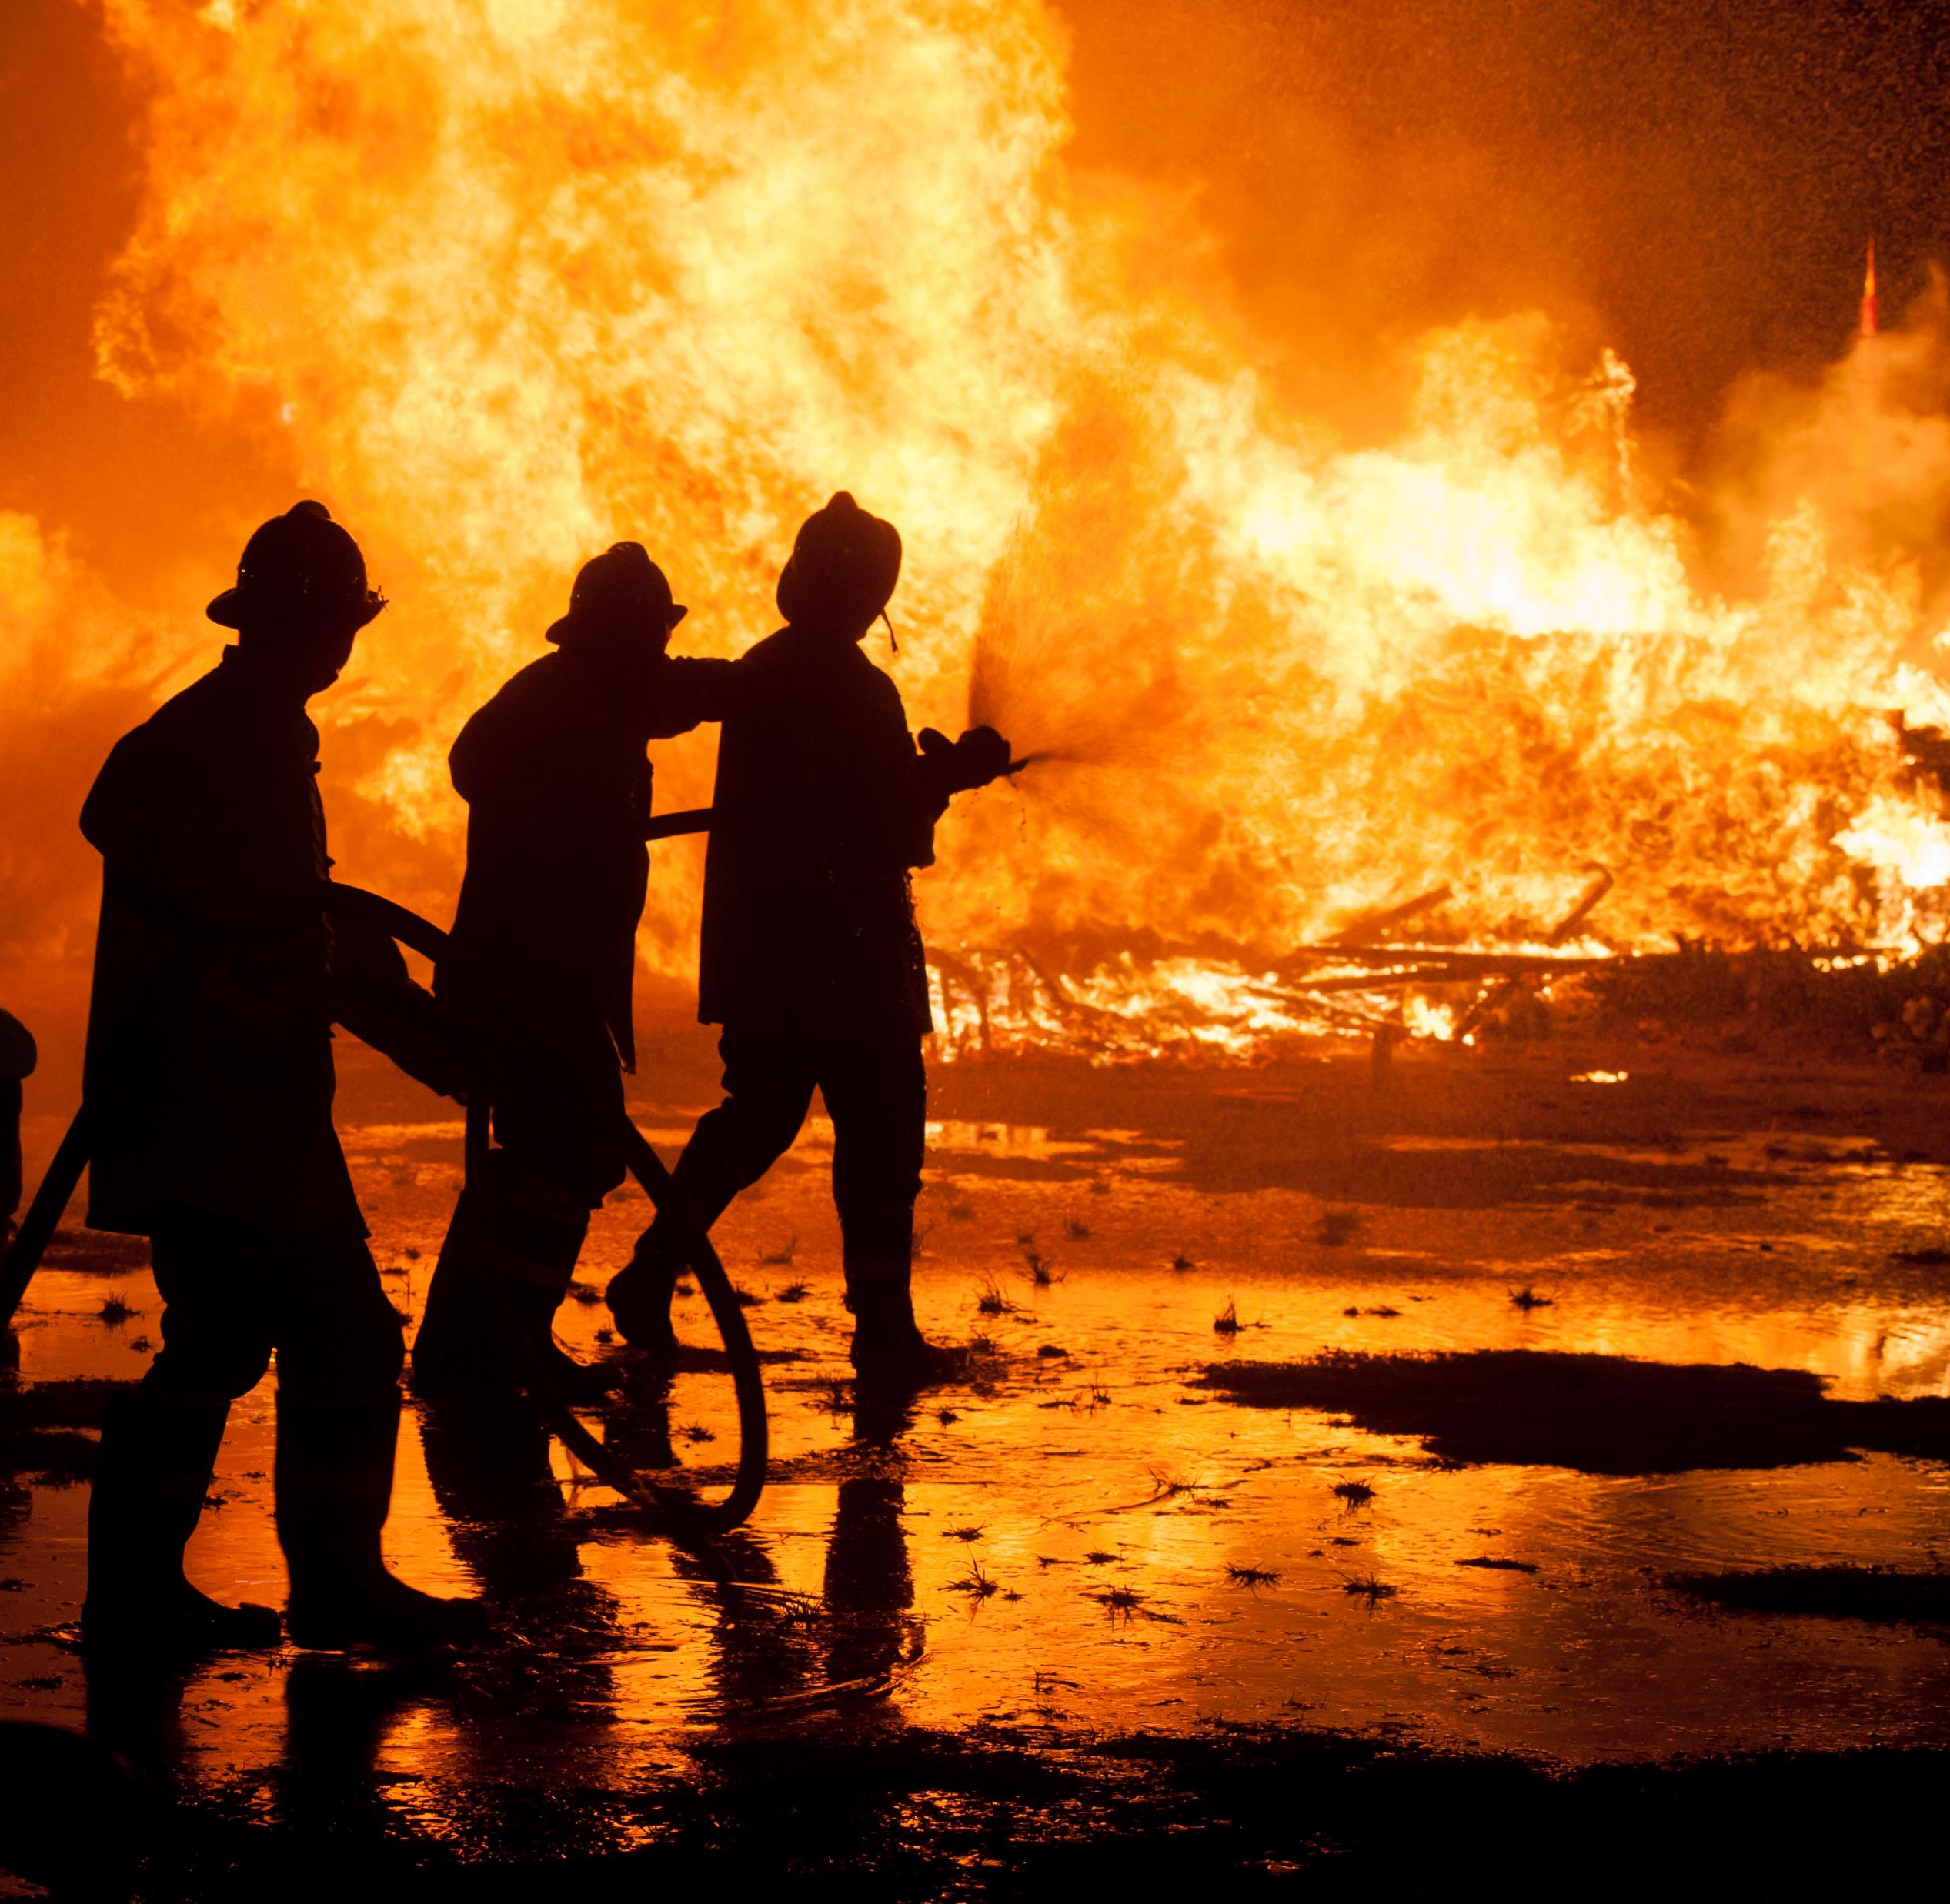
Tabletop Exercise
Burn Surge Annex

Slide 10
Exercise Scope
This TTX is an interactive, discussion-based exercise focusing on impacts to healthcare coalition and healthcare facilities caused by mass casualty events with large numbers of burn patients.

Slide 11
HPP Program Capabilities Tested
Instructions for Use:
Add or change based on exercise planning at the HCC level. Adjust width of main text box.
[delete prior to presentation]
Capability 2: Health Care and Medical Response Coordination
  Objective 1: Develop and Coordinate Health Care Organization and Health Care Coalition Response Plans
Capability 4: Medical Surge
  Objective 1: Plan for a Medical Surge
  Objective 2: Respond to a Medical Surge

Slide 12
Exercise Objectives
Instructions for Use:
Other objectives identified by the Exercise Planning Team. Adjust width of main text box.
[delete prior to presentation]
Review existing burn care assets and identify gaps that may occur in a burn mass casualty incident.
Review agency/facility role in a burn mass casualty incident.
Validate assumptions in the HCC Burn Surge Annex.
Identify changes that need to be made in the HCC Burn Surge Annex based on the roles and capabilities of the involved partners.

Slide 13
Guidelines
Open, low-stress, no-fault discussion environment.
Comments will be non-attributable.
Be professional and respect other’s opinions based on their knowledge.
Responses should be based on knowledge of current plans and capabilities.
  You do not have to have all the answers.
Decisions are not precedent setting.
Problem-solving efforts should be the focus – more questions than answers may be generated.
The situation updates, written material, and resources provided are the basis for discussion.
Participants are encouraged to use the SitMan as a reference and to fill out the Participant Feedback Form as you go; feedback is welcome!
Use notes pages available in the SitMan.

Slide 14
Assumptions and Artificialities
During this exercise, the following apply:
The scenario for this exercise is artificial, however, it is plausible, and events occur as they are presented.
There are neither “hidden agendas” nor any “trick questions.”
All players receive information at the same time.
Assume cooperation and support from other responders, agencies, and organizational entities.

Slide 15

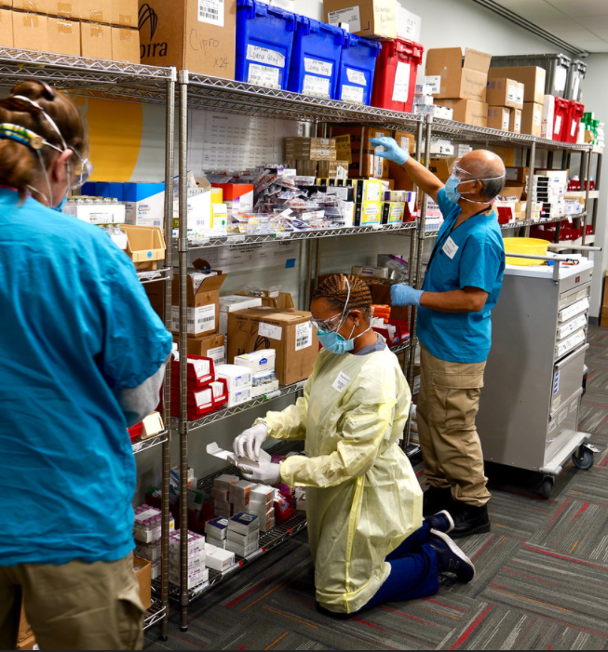
Module 1
Monday afternoon, May 10, 3:00 pm
Your hospital is at normal staffing and supply levels. Your hospital is at your average daily occupancy.
Notification from EMS of large fire at your community/ convention center.
Up to 4,000 attendees. (Note: small / rural coalitions may adjust this number down to 100-200 depending on appropriate scale)
Hundreds of people have been injured, including burns, smoke inhalation, and minor and major traumas.
The first wave of patients is expected in 15 minutes.
Notes:
Note: This module focuses on the hospital response to this incident and not the pre-hospital response.

Slide 16
Module 1 Discussion Questions
What is the EMS plan for local distribution of burn casualties? Which patients go to which hospitals if there are multiple potential receiving hospitals? What role does your facility play in a burn mass casualty?
What are your initial actions upon notification of this incident? What do you need to do to activate your disaster plan? Do you have a burn surge plan? If yes, how is it activated?
How could your facility access real-time expert assistance via consultation with a Burn Center Physician, either through a nearby Burn Center or through a state or regional Burn Coordination Center, Medical Operations Coordination Center, etc.? Are the other hospitals in the area using the same resources?
Notes:
Note this discussion module is focused on EMS and hospital clinical care – PH and EM should concentrate on question 1 and 3.
This is intended to be a progressive exercise starting with an individual facility and progressing to coalition-wide management.

Slide 17
Module 1 Discussion Questions (continued)
Does your facility have telehealth / telemedicine agreements with a Burn Center or trauma center (if there is no regional burn center) for additional assistance?
Does your facility have Burn Triage cards or other quick reference resources?
How many burn patients is your facility prepared to handle?
  Do you provide burn inpatient care?
  What supplies do you have on-hand to manage burn patients?
  What staff do you have on-hand to manage a surge of burn patients?
  What burn care training does your hospital emergency department and inpatient staff have?
  Do you have a plan to provide just-in-time burn care training?
Notes:
Note this discussion module is focused on EMS and hospital clinical care – PH and EM should concentrate on question 1 and 3.
This is intended to be a progressive exercise starting with an individual facility and progressing to coalition-wide management.

Slide 18
Module 1 Discussion Questions (continued)
What changes to your facility disaster plan are needed to accommodate a burn surge?
In the event that your facility’s burn capacity is exceeded, or you do not provide burn services, how would you address referring these cases to a larger and/or burn specialty hospital?
  What is the current referral process for a critically ill patient and how would this change in this incident?
  How would you prioritize/triage multiple burn referrals from your facility?
  Does your facility have written agreements with burn referral centers to expedite patient transfer?
  What patient transportation resources would you need?
Notes:
Note this discussion module is focused on EMS and hospital clinical care – PH and EM should concentrate on question 1 and 3.
This is intended to be a progressive exercise starting with an individual facility and progressing to coalition-wide management.

Slide 19

Module 1 Report Out
Each table provide top 3 lessons, due outs, action items.
Provide the rest of your notes to the exercise facilitator.
Please select a team scribe with legible handwriting.
Notes:
Supply those who will report out with a note pad and pen/ pencil at the beginning of the exercise and assign a scribe for each report out team, preferably someone whose handwriting can be read.

Slide 20
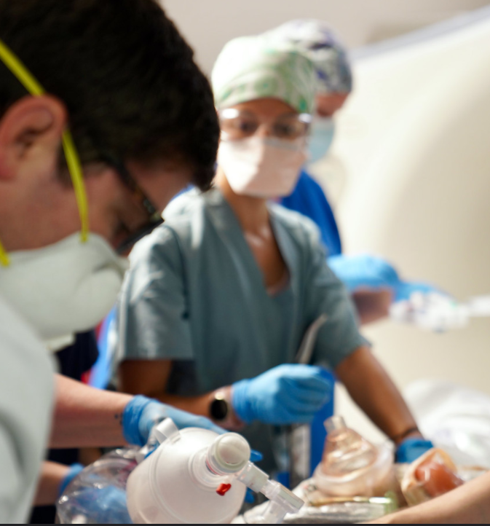
Module 2
Monday afternoon, May 10, 5:00 pm (Incident + 2 hours)
You have now received significant numbers of patients and your surge capacity has been exceeded.
Your usual burn referral center is 100 miles away
You must stabilize and treat the burn patients at the local hospitals for now, in addition to others who are not burned and have also sustained critical injuries.

Slide 21
Module 2 Discussion Questions
What alerts and notification mechanisms are in place to ensure that the coalition members and partners are aware of the incident?
How does the HCC support this response?
  If the coalition has an operations center how is this activated, staffed, and what functions does it serve? How does it interface with the EOC?
  If the coalition functions are conducted by/at the jurisdictional EOC how rapid is the activation? Who provides coordination and supports the healthcare needs?
  How will the HCC support resource allocation decisions in a scarce resource environment (e.g, transportation, staff, supplies)?
What type of assistance (staff, space, resources, systems) could the HCC and its members provide? Are there other partners that you should coordinate with? Is this different from Emergency Support Function (ESF)8 support?

Slide 22
Module 2 Discussion Questions (continued)
When would you notify and request assistance from emergency management and what would you need?
What emergency medical services (EMS) transport resources are available (both public safety and private services)? (EMS: consider both ground and air assets.)
Where would you obtain guidance or clinical advice for burn patient care prior to and during an event? What types of burn or other experts might be needed that are not yet included? How do you communicate with them (e.g., telephone/telemedicine)? Is there a role for bringing a burn provider and supplies to the community to assist / support? How would that be managed?

Slide 23
Module 2 Report Out
Each table provide top 3 lessons, due outs, action items.
Provide the rest of your notes to the exercise facilitator.
Please select a team scribe with legible handwriting.
Notes:
Supply those who will report out with a note pad and pen/ pencil at the beginning of the exercise and assign a scribe for each report out team, preferably someone whose handwriting can be read.

Slide 24
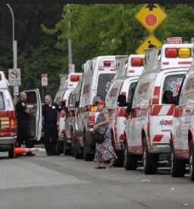
Module 3
Monday afternoon, May 10, 7:00 pm and beyond (Incident + 4 hours)
Multiple burn patients have been stabilized at area hospitals and they now require secondary transfer for ongoing care. Some patients will be accommodated at trauma centers or will need to be cared for locally until transport / inpatient burn capacity catches up to demand.
Specialty transportation resources may be needed for patient movement.

Slide 25
Module 3 Discussion Questions
How does the HCC Burn Surge Annex address this kind of scenario?
How will the team coordinate sharing patient information across multiple facilities for patient tracking and family re-unification?
How can the coalition ensure patient load balancing among hospitals or play a role in transfer decisions locally if relevant (e.g., movement to trauma center if burn center is overwhelmed)? How will hospitals and EMS coordinate this decision making?
If the coalition does not serve in this role, do you know how to notify state or substate Medical Operations Coordination Centers or Regional Burn Center? What role would they play?

Slide 26
Module 3 Discussion Questions (continued)
Who will be responsible for prioritizing patient transfers to the burn center and what criteria will be used to make that determination? How will the receiving burn center participate in those decisions?
How will transportation be coordinated for these patients?
What is the mechanism for tracking these patients through the referral process?
What resources does your facility have onsite if you need to provide ongoing care instead of transferring a critical burn patient? If on-site staff would be required to care for these patients, is there a staff sharing mechanism or agreement(s) to support this? Are telemedicine capabilities available? Has a common point of contact been identified for clinical advice?

Slide 27
Module 3 Report Out
Each table provide top 3 lessons, due outs, action items.
Provide the rest of your notes to the exercise facilitator.
Please select a team scribe with legible handwriting.
Notes:
Supply those who will report out with a note pad and pen/ pencil at the beginning of the exercise and assign a scribe for each report out team, preferably someone whose handwriting can be read.

Slide 28

Wrap Up
Closing comments

Slide 29

Hotwash
Immediate feedback from participants
  One positive about the exercise (something you learned, something you can implement immediately)
  One item of correction or action from the exercise (something you would like to take back for immediate action)
Participants should fill out the Participant Feedback Form and submit it before they leave TODAY.

Slide 30

Next Steps
Instructions for Use:
Suggested next steps. Update as appropriate.
[delete prior to presentation]
Each participant / facility should prepare their own action items to close any noted gaps, in addition to the coalition-wide After Action Report and Improvement Plan
Compile notes and comments, and produce an After Action Report and Improvement Plan
Share Improvement Plan with coalition members and any entity with an action item
Implement action items in the Improvement Plan such as updating plans, and address any training or equipment needs
Notes:
Exercise Planning Team can add additional next steps and the facilitator should recap the action steps discussed in the hotwash

